Slide 1
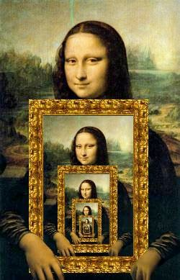

Chapter 3: Recursion

Slide 2
Recursive definitions
Prolog predicates can be defined recursively
A predicate is recursively defined if one or more rules in its definition refers to itself

Slide 3
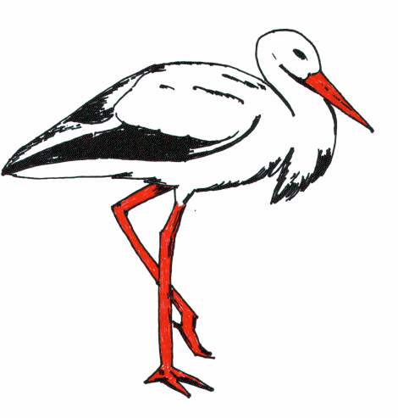
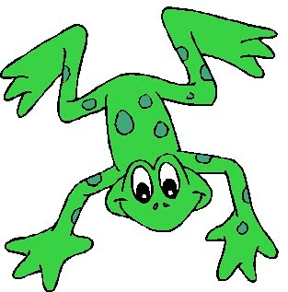
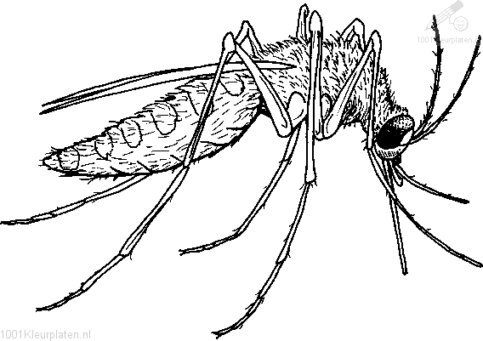

Example 1: Eating

Slide 4
Example 1: Eating
isDigesting(X,Y):- justAte(X,Y). isDigesting(X,Y):- justAte(X,Z), isDigesting(Z,Y).
justAte(mosquito,blood(john)). justAte(frog,mosquito). justAte(stork,frog).
?-

Slide 5
Picture of the situation
justAte
X
Y
isDigesting
justAte
isDigesting
X
Z
Y
isDigesting

Slide 6
Example 1: Eating
isDigesting(X,Y):- justAte(X,Y). isDigesting(X,Y):- justAte(X,Z), isDigesting(Z,Y).
justAte(mosquito,blood(john)). justAte(frog,mosquito). justAte(stork,frog).
?- isDigesting(stork,mosquito).

Slide 7
Example 1: Eating
isDigesting(X,Y):- justAte(X,Y). isDigesting(X,Y):- justAte(X,Z), isDigesting(Z,Y).
justAte(mosquito,blood(john)). justAte(frog,mosquito). justAte(stork,frog).
?- isDigesting(stork,mosquito). yes
?-

Slide 8
Example 2: Decendant
child(bridget,caroline). child(caroline,donna).
%% Base cases
descend(X,Y):- child(X,Y).
%% Inductive cases
descend(X,Y):- child(X,Z), child(Z,Y).

Slide 9
Example 2: Decendant
child(anna,bridget).
child(bridget,caroline). child(caroline,donna). child(donna,emily).
descend(X,Y):- child(X,Y). descend(X,Y):- child(X,Z), child(Z,Y).

Slide 10
Example 2: Decendant
child(anna,bridget).
child(bridget,caroline). child(caroline,donna). child(donna,emily).
descend(X,Y):- child(X,Y). descend(X,Y):- child(X,Z), child(Z,Y).
?- descend(anna,donna). no
?-

Slide 11
Example 2: Decendant
child(anna,bridget). child(bridget,caroline).
child(caroline,donna). child(donna,emily).
descend(X,Y):- child(X,Y). descend(X,Y):- child(X,Z), child(Z,Y).
descend(X,Y):- child(X,Z), child(Z,U), child(U,Y).
?-

Slide 12
Example 2: Decendant
child(anna,bridget).
child(bridget,caroline). child(caroline,donna). child(donna,emily).
descend(X,Y):- child(X,Y). descend(X,Y):- child(X,Z), descend(Z,Y).
?-

Slide 13
Example 2: Decendant
child(anna,bridget).
child(bridget,caroline). child(caroline,donna). child(donna,emily).
descend(X,Y):- child(X,Y). descend(X,Y):- child(X,Z), descend(Z,Y).
?- descend(anna,donna).

Slide 14
Search tree
Draw search tree for
?- descend(anna,donna).

Slide 15
directTrain(saarbruecken,dudweiler).
directTrain(forbach,saarbruecken).
directTrain(freyming,forbach).
directTrain(stAvold,freyming).
directTrain(fahlquemont,stAvold).
directTrain(metz,fahlquemont).
directTrain(nancy,metz).
travelFromTo(X,Y):-directTrain(X,Y).
travelFromTo(X,Y):-directTrain(X,Z),travelFromTo(Z,Y).
query:
travelFromTo(nancy,saarbruecken).
True.
travelFromTo(saarbruecken,nancy).
False.

